Slide 1
Quality Assurance Framework, Dissemination, Specialised Topics
Habib Khan (khan39@un.org) United Nations Statistics Division
Notes:
1

Slide 2
Quality assurance framework
Quality assurance
Objectives of quality assurance:
To provide compilers with the appropriate information to monitor and further enhance data quality; and
To provide users with sufficient information to judge whether the data are adequate for their intended use.
Quality assurance frameworks:
Many countries and organizations have developed different frameworks over the years.
In 2019, the UN Statistical Commission endorsed the United Nations National Quality Assurance Frameworks Manual for Official Statistics (UN-NQAF).

Slide 3
Quality assurance framework
(NEW) UN-NQAF
Quality principles
General propositions, or procedures, which guide activities of the national statistical system in meeting their quality-related objectives
Quality requirements
Each quality principle is detailed by a set quality requirement describing what must be done to ensure that the given principal is implemented
Elements to be assured
For each principle, such as possible activities, methods and tools

Slide 4
Quality assurance framework
Quality indicators
It is recommended that countries develop and use a system of quality indicators.
It is recommended that the quality indicators satisfy the following criteria:
They cover all dimensions of quality;
They are based on the consistent application of sound methodologies and processes; and
They are easy to interpret by both internal and external users.
It is recommended that countries maintain a balance between the scope of quality dimensions and a practical number of indicators.
Accuracy
Application of confidentiality and its impact.
Use of data validation techniques and their impact.
Timeliness
Time lag between the end of the reference period and first release
Accesibility
Availability of digital dissemination platforms, such as machine-readable formats and databases that can be queried by users

Slide 5
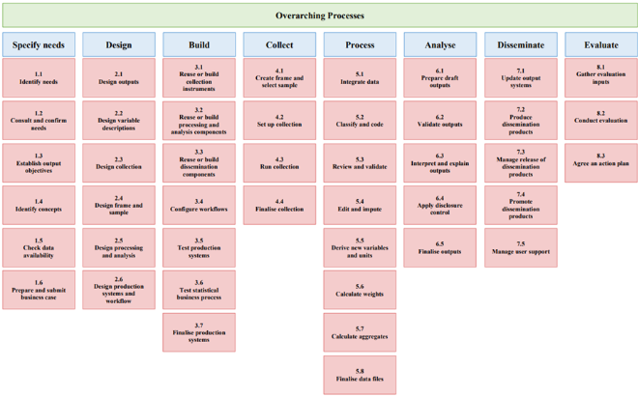
Quality assurance framework
Generic Statistical Business Process Model
The GSBPM facilitates the assurance of UN-NQAF quality principles and requirements

Slide 6
Quality assurance framework
Metadata
Metadata is data about data.
It is recommended that countries at least cover the following categories of metadata for their IMTS:
All underlying concepts and definitions.
The legal framework, institutional arrangements, and data sources.
Data-collection and data-processing procedures.
Estimation methods.
Data dissemination policy (release and revision schedules).
Description of all data fields.
Explanations and footnotes (e.g., revisions, break in series).
Quality reporting.
(NEW) Countries are encouraged to adopt the Statistical Data and Metadata Exchange (SDMX) standard

Slide 7
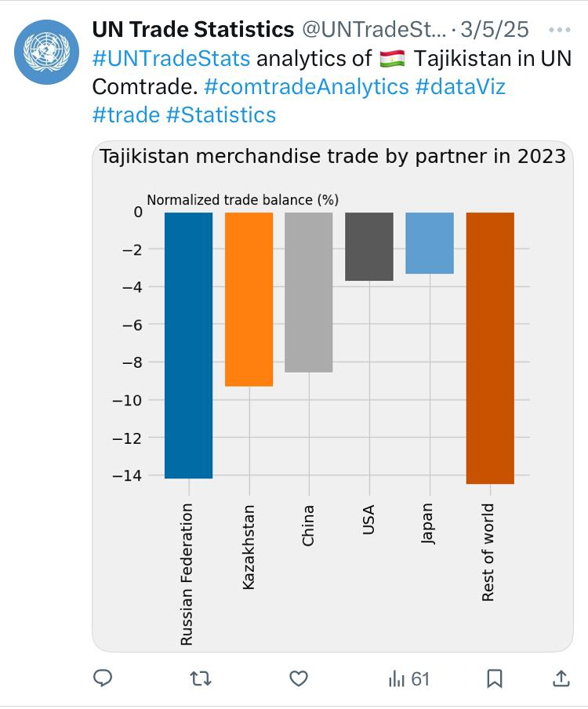
Dissemination
Data dissemination
It is recommended that
All user needs are treated equally.
Countries choose the dissemination format that best suits their user's needs (e.g. press releases and/or social media posts, visualization, tables and charts).
IMTS be accessed through digital dissemination channels (e.g. websites)
countries are further encouraged to consider a range of digital dissemination platforms, such as machine-readable formats and databases.

Slide 8
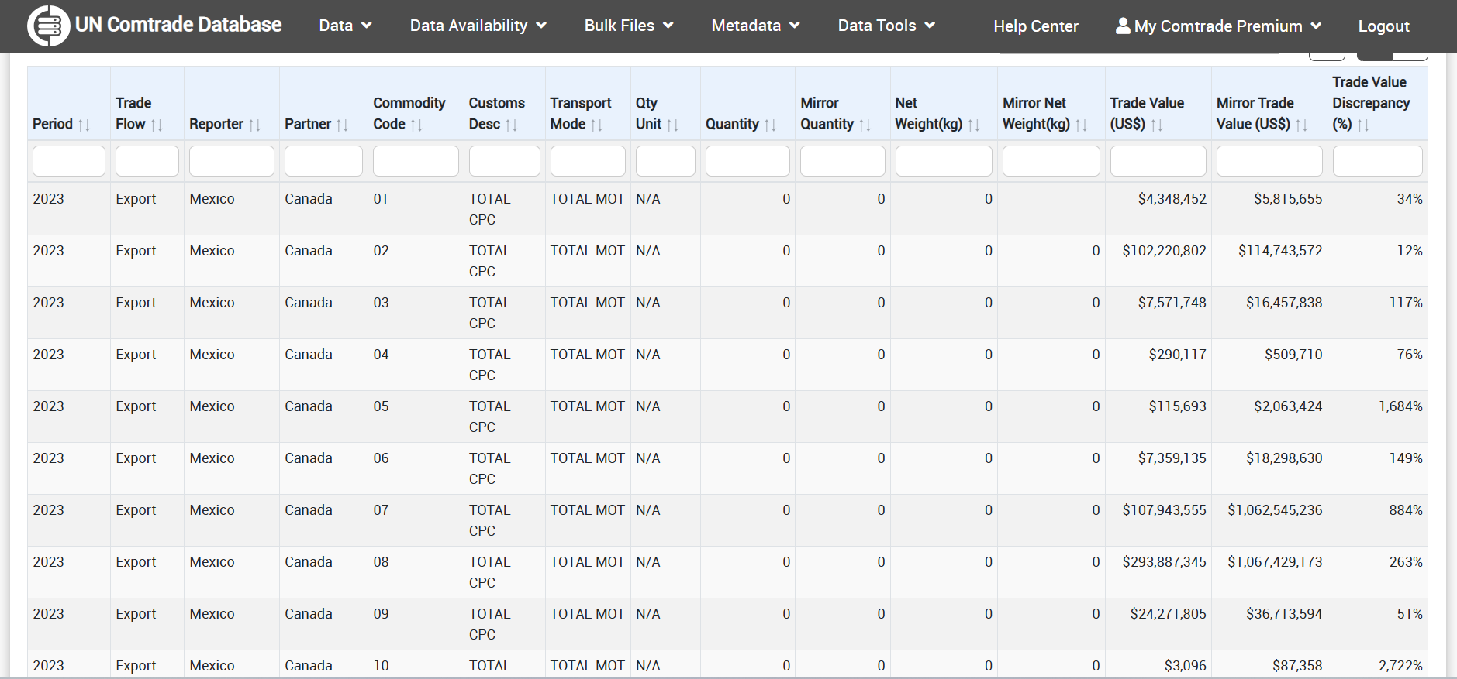
Dissemination
Data communication
It is recommended that
Countries develop a communication strategy (well-explained, and easy to use and interpret).
Efforts are made to identify and address erroneous interpretation of data.
Countries are encouraged to cooperate with international and regional organizations in dissemination (important because of the bilateral nature of IMTS).

Slide 9
Dissemination
Confidentiality, release calendar
Confidentiality (recommended)
Passive confidentiality be applied as much as possible.
When suppressing data due to confidentiality,suppressed data should be reported in full detail at the next higher level of commodity and/or partner aggregation without compromising confidentiality.
Release calendar (encouraged)
Monthly totals of exports and imports within 45 days after the end of the reference month, at least by major trading partners and basic commodity breakdown;
Quarterly data within 60 days after the end of the reference quarter;
Annual data within 90 days after the end of the reference year.

Slide 10
Specialized topics
Trade and other domains
Impact of trade on environment and sustainability
Impact of trade on Wellbeing, Labor, and Productivity
Cultural and creative industry goods
Global production arrangements and value chains
Digital trade
Indicators on trade statistics (MPIBTS, vol-2)

